Slide 1
Keep Stepping
Healing through movement

Slide 2

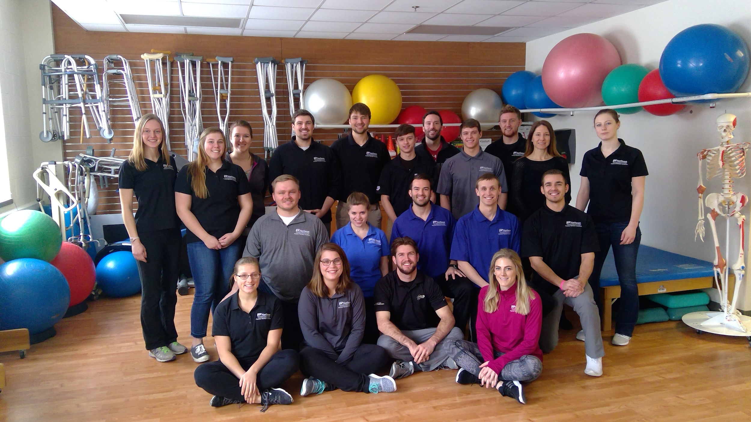
Welcome
-Meet your buddy
-Grab your water
-Vitals

Slide 3
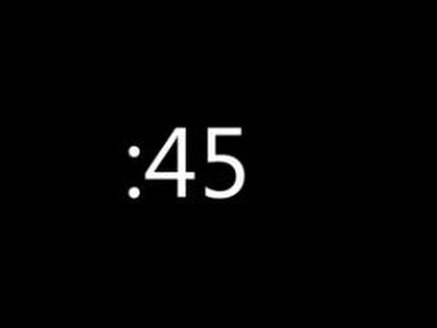


It’s Dancing Time

Slide 4
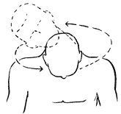
Neck Circles

Slide 5
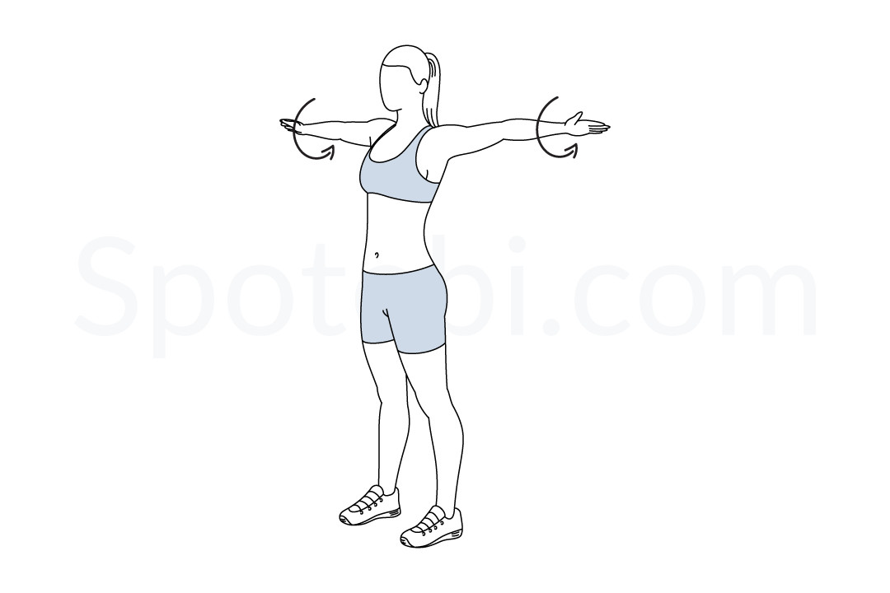
Arm Circles

Slide 6
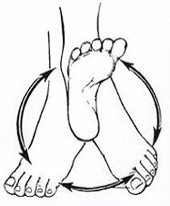
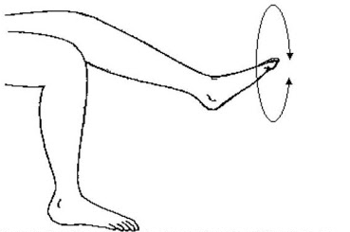
Ankle Circles

Slide 7
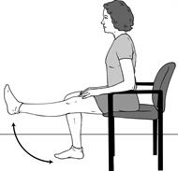
Knee Extensions

Slide 8
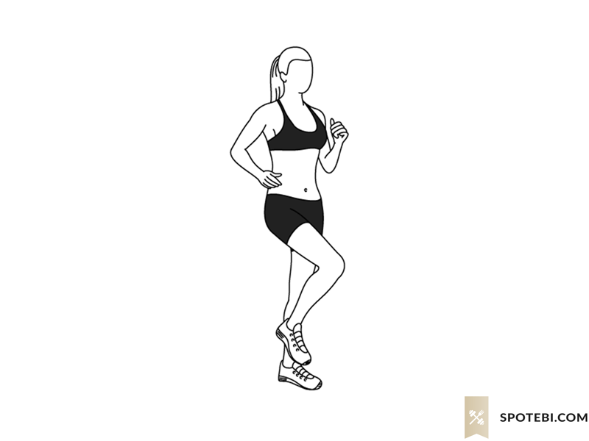
Marching with Arm Pumps
Marching with Arm Pumps

Slide 9
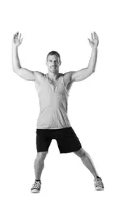
Side Step, Side Step

Slide 10

Let's Get Walking!
6 Minute Walk

Slide 11
Senior Fitness Test
Height/weight
Arm Curls
Chair Sit to Stand
Timed Up and Go
Back Scratch
Sit and Reach
BP/Pulse

Slide 12

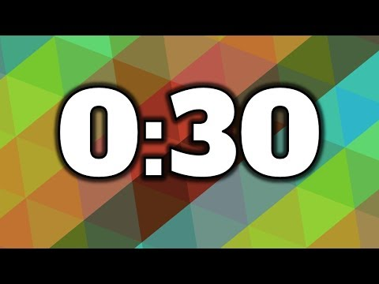
Stations
Work:
Rotate:

Slide 13
Cool Down
-Quad stretch
-Calf stretch
-Hamstring stretch
-Lat bend/QL stretch
-Cross body arm stretch
-Wrist extension/flexion
-Diaphragmatic breathing

Slide 14
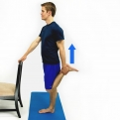
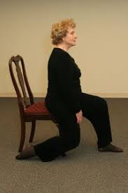
Quad Stretch

Slide 15
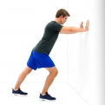
Calf Stretch

Slide 16
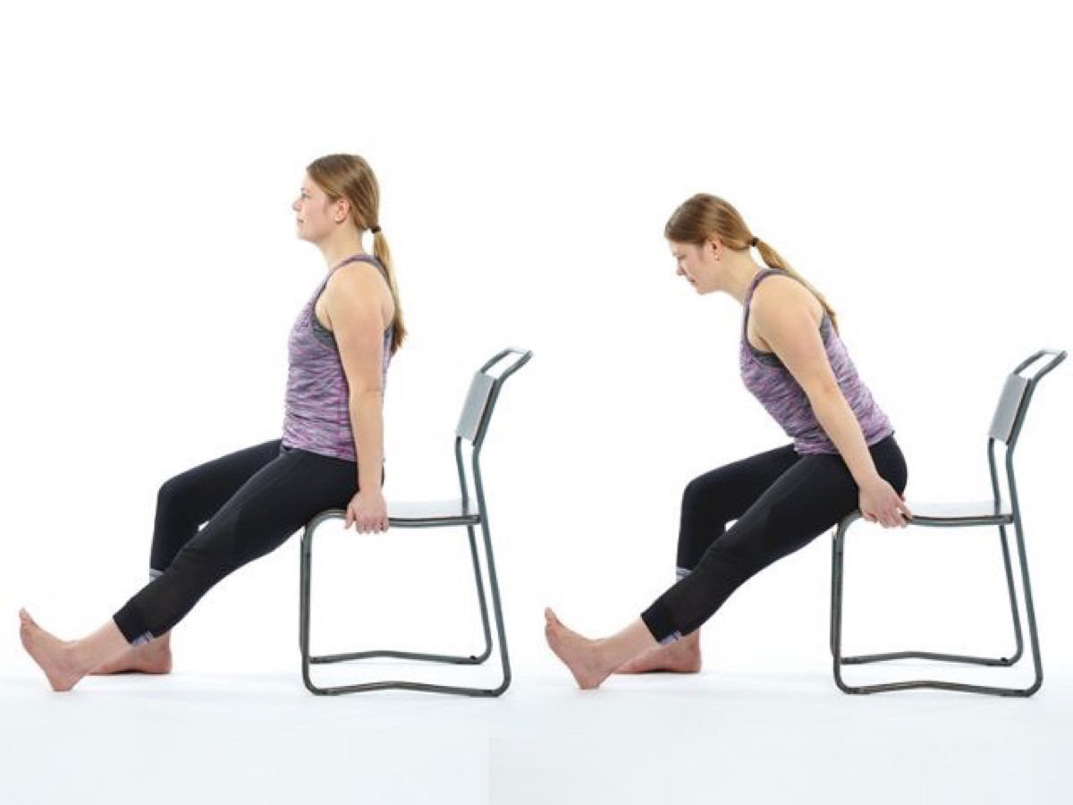
Hamstring Stretch

Slide 17
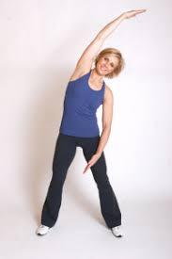
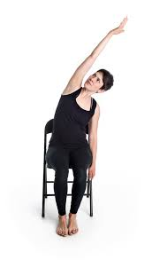
Lateral Bend

Slide 18
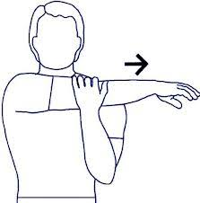
Cross Body Arm Stretch

Slide 19
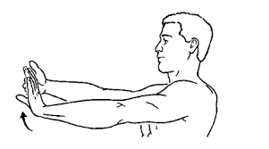
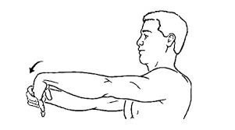
Wrist Extension/Flexion

Slide 20
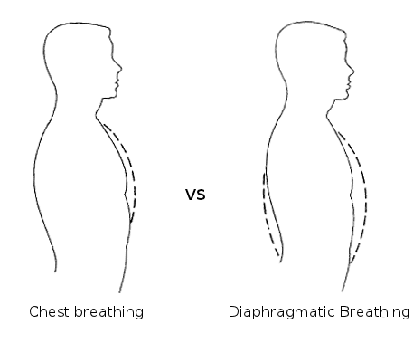
Diaphragmatic Breathing

Slide 21
Vitals

Slide 22

Finished!

Slide 23
Education Topic of the Week!

